Slide 1

The 23rd Psalm
Psalms of Guidance
April 3, 2022

Slide 2
Faith – “The Lord is my Shepherd”
Jesus said, “I am the good shepherd …” John 10:11
The church is His flock of sheep. John 10:16;
Acts 20:28
Jesus said His sheep hear His voice and follow Him.
John 10:27
cf. Romans 10:17, “So then faith cometh by hearing, and hearing by the word of God.”
They do not follow strangers. John 10:5
Is Christ your shepherd and are you following Him?

Slide 3
Assurance – “I shall not want”
cf. 1 Samuel 17:32-37 – David challenging Goliath.
Results from teaching. Psalms 37:23-25; Matthew 6:33
God will supply our needs. Matthew 7:7-8;
Hebrews 13:5-6; 2 Corinthians 9:6-11
Hebrews 10:22, “Let us draw near with a true heart in full assurance of faith, having our hearts sprinkled from an evil conscience, and our bodies washed with pure water.” (KJV)

Slide 4
Contentment – “He maketh me to lie down in green pastures”
1 Timothy 6:6, “But godliness with contentment is great gain.” cf. verses 7-8; Philippians 4:11-13
Failing to be satisfied leads to other sins:
  Covetousness. Luke 12:13-15
  Envy, jealously, and strife.

Slide 5
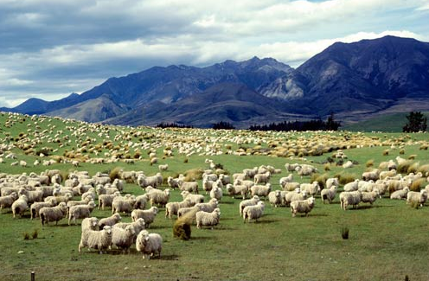
cf. Psalms 65
Praise And Thanksgiving For God’s Abundant Favor To Earth And Man
God’s provisions for His people. Verses 9-13
Psalms 65:13, “The pastures are clothed with flocks; the valleys also are covered over with grain; they shout for joy, they also sing.” REST. Ezekiel 34:11-16, 23-25
The pastures of the wilderness were the places where flocks
grazed (Luke 15:4;
1 Samuel 25:1-4) – so, when God watered the pastures
abundantly (verses 9-11), the pastures would become clothed with flocks.

Slide 6
Peace – “He leadeth me beside the still waters”
Restless and troubled waters are dangerous.
cf. Mark 4:36-41
The still quiet waters are peaceful and safe.
Mark 4:38
Living water (everlasting life). John 4:10-14
Jesus is our “Prince of Peace.” cf. Isaiah9:6
Peace is valuable. Philippians 4:7; Matthew 5:9;
Romans 14:19; 1 Peter 3:10-12; Romans 12:18;
Ephesians 4:1-4
“Let him who thirsts come … whoever desires, let him take the water of life freely” Revelation 22:17

